Slide 1
This is a hidden slide
Dear honorable teacher please follow the instructions that has given in the slide notes. (under the every slide). It would be helpful to take a successful class. Thanks a lot. I wish you good luck.

Slide 2
WELCOME
Notes:
Teacher can say it orally.

Slide 3
Identity
S.K.Md. Harunar Rashid
- Senior Assistant teacher
Sonatola Model High School
Bogra.
English For Today
Class : Six.
Lesson 3
Notes:
Teacher can hide this slide.

Slide 4
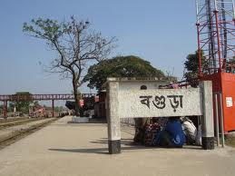
Today`s topic
At a Railway Station

Slide 5
Learning outcomes
After completing the lesson students will be able to…
read and understand texts
Talk about people, places and familiar objects in short and simple sentences
Write paragraph, letter, compositions.

Slide 6
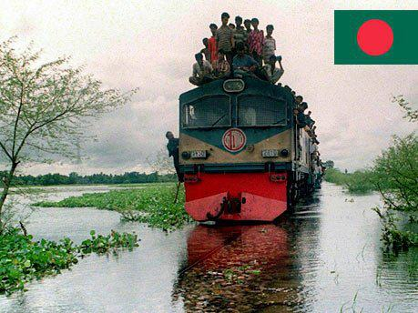
Let`s enjoy a video clip
A railway station
What is the name of this place ?
Notes:
After showing the video teacher can try to elicit the answer then he/she will give feedback.

Slide 7
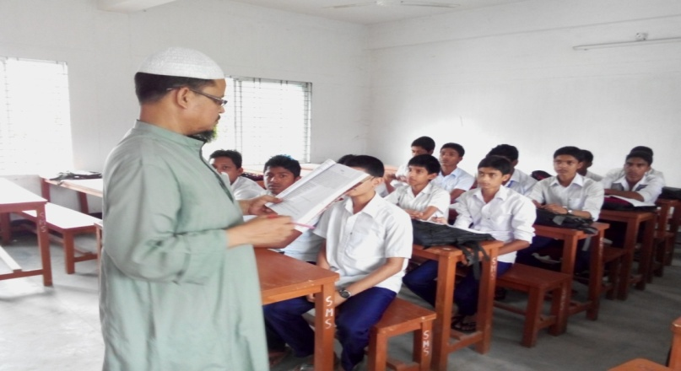
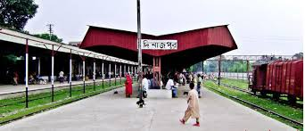
Listen the text attentively then talk with your partner about what the speaker saw and did at the railway station. Use your own words.
Notes:
Teacher will read the text proper way then he/she will ask his/her students to discuss with their pairs.

Slide 8
See off
Key word
I came to see him off.
Meaning
(Click here)
Good Bye / Bid farewell
Notes:
At first teacher will show the words then ask his/her students to tell the meaning and making sentences. If they fail teacher will show the picture again. For feedback click on meaning button.

Slide 9
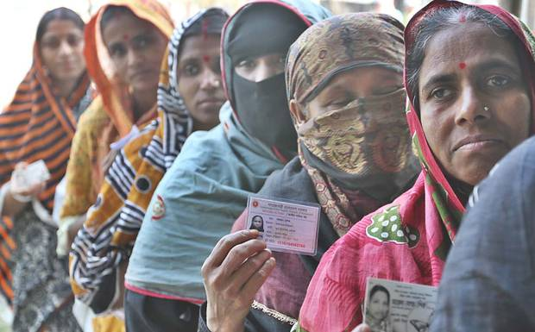
Queue
Key word
They are standing in the queue for vote.
Meaning
(Click here)
Line
Notes:
At first teacher will show the words then ask his/her students to tell the meaning and making sentences. If they fail teacher will show the picture again. For feedback click on meaning button.

Slide 10
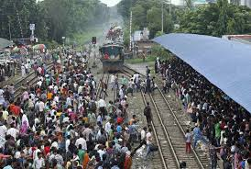
Crowded
Key word
There are very crowded in the station.
Meaning
(Click here)
Packed by people.
Notes:
At first teacher will show the words then ask his/her students to tell the meaning and making sentences. If they fail teacher will show the picture again. For feedback click on meaning button.

Slide 11
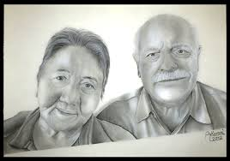
Couple
Key word
An old couple is waiting for train.
Meaning
(Click here)
Pair
Notes:
At first teacher will show the words then ask his/her students to tell the meaning and making sentences. If they fail teacher will show the picture again. For feedback click on meaning button.

Slide 12
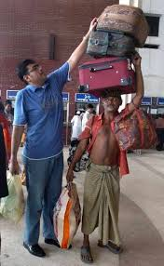
Luggage
Key word
A man is carrying his luggage.
Meaning
(Click here)
baggage
Notes:
At first teacher will show the words then ask his/her students to tell the meaning and making sentences. If they fail teacher will show the picture again. For feedback click on meaning button.

Slide 13
Similar and opposite words.
Main Word | Similar Word | Opposite Word
See off | Goodbye | Receive
Long | Far | Short
Quiet | Silent | Busy
Heavy | Weight | Light
Pick up | Take off | Drop
Young | Youth | Old
Now go to the section - A2 and match the words.
Notes:
At first teacher will discuss the synonym and antonym of the key words then will go to the section - A2 for evaluation.

Slide 14
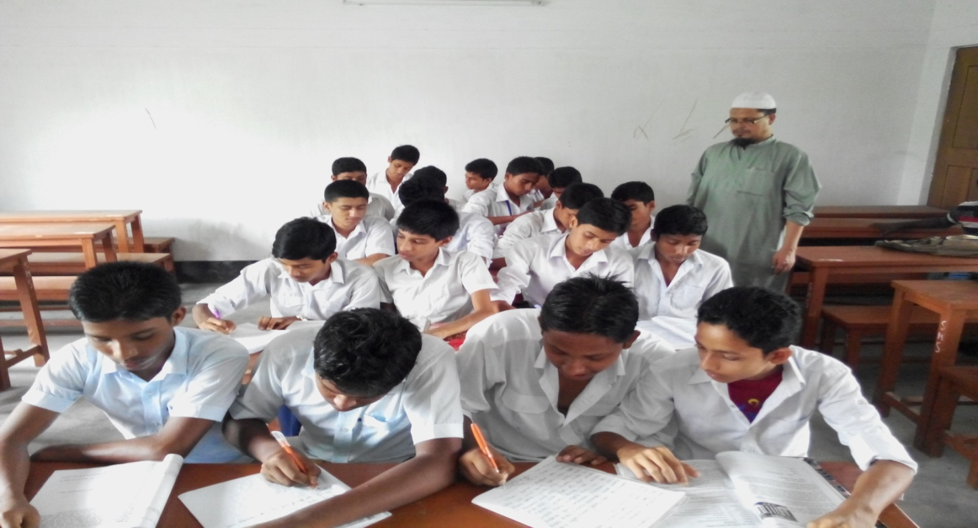
Silent reading
Now go to the next slide and fill in the gaps.
Notes:
Teacher will monitor and help the students. Then will do the next task in next slide.

Slide 15
Individual work
Fill in the gaps with the word from the box.
Once the writer and his friend were (a) ---------- the station. They were (b)--------- for the train. His friend © --------- was going to Dhaka and he came to see him (d)--------. He found the station very (e) ------- . There was a long line of people at the (f) -------- . A woman in the line (g) -------- her child tightly. The writer also saw a group of (h) ------ people was talking and taking tea. There was a (i) ------- of old people trying to find a resting place. Another passenger a young (j) ------- was sitting on her luggage and reading a magazine.
Lady
held
waiting
room
crowded
long
young
at
Sajjad
couple
Ticket counter
off
Notes:
At first students will try to fill in the gaps individually. If they do wrong then teacher click the mouse and students will compare with their answers.

Slide 16
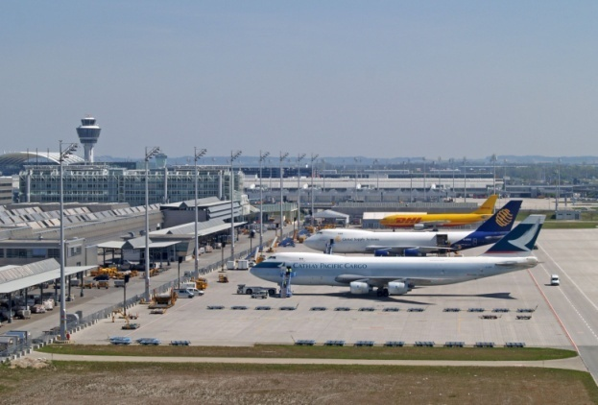
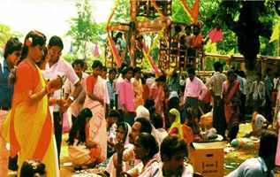
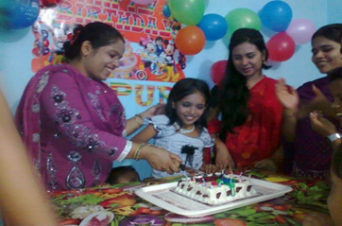
Pair Works
Suppose you went to one of the places listed below.
Describe what you saw, what was happening and what you did there (within five sentences).
1. An Air Port
2. A Village Fair
3. Sumi`s Brith day
Notes:
At first teacher will divided whole class into groups then will give them one item for each group.

Slide 17
Home works.
Visit your local railway station and write down five sentences on it.
Notes:
There is no railway station, teacher can ask to students to go to bus station, launch ghat, airport, market etc.

Slide 18
Acknowledgement
We would like to express our cordial gratitude to the Ministry of Education, Directorate of Secondary & Higher Education, NCTB, a2i
and
the panel of honorable editors ( Md. Jahangir Hasan, Associate Professor (English) TTC, Rangpur, Ranjit Poddar, Associate Professor (English) TTC, Dhaka, and Urmila Ahmed, Associate Professor (English) TTC, Dhaka, to enrich the contents.

Slide 19
GOOD BYE
SEE
AGAIN
YOU
Notes:
Teacher can say it orally.

